Slide 1

Introduction to Classes and Objects
In this video, we're going to start talking about Object Oriented Programming.
COMPLETE JAVA MASTERCLASS
Introduction to Classes and Objects

Slide 2
What is Object Oriented Programming
What is Object Oriented Programming?
Object oriented programming is a way to model real world objects, as software objects, which contain both data and code.
OOP is a common acronym for Object Oriented Programming.
COMPLETE JAVA MASTERCLASS
Introduction to Classes and Objects

Slide 3
Class-based Programming
Class-based programming starts with classes, which become the blueprints for objects.
But what does this really mean?
So, to start, we need to understand what objects are.
They're really the key to understanding this Object Oriented terminology.
COMPLETE JAVA MASTERCLASS
Introduction to Classes and Objects

Slide 4
Real World Object Exercise
So what I'd like you to do, is just have a look around, in the area you're sitting in right now.
And if you do that, you'll find that there's many examples of real world objects.
For example, I'm sitting here and I can see:
A computer
I can see a keyboard
I can see a microphone
I can see shelves on the wall
I can see a door
All of these are examples of real world objects.
COMPLETE JAVA MASTERCLASS
Introduction to Classes and Objects

Slide 5
State and Behavior
Now, Real world objects have two major components:
state
and behavior
COMPLETE JAVA MASTERCLASS
Introduction to Classes and Objects

Slide 6
State (computer)
So State, in terms of a computer object, might be:
The amount of RAM it has
The operating system it's running
The hard drive size
The size of the monitor
These are characteristics about the item, that can describe it.
COMPLETE JAVA MASTERCLASS
Introduction to Classes and Objects

Slide 7
State (ant)
We could also describe animate objects, like people or animals, or even insects, like an ant.
For an ant, the state might be:
The age
The number of legs
The conscious state
Whether the ant is sleeping or is awake
COMPLETE JAVA MASTERCLASS
Introduction to Classes and Objects

Slide 8
Behavior (computer)
In addition to state, objects may also have behavior, or actions that can be performed by the object, or upon the object.
Behavior, for a computer, might be things like:
Booting up
Shutting down
Beeping, or outputting some form of sound
Drawing something on the screen, and so on
All of these could be described as behaviors for a computer.
COMPLETE JAVA MASTERCLASS
Introduction to Classes and Objects

Slide 9
Behavior (ant)
For an ant, behavior might be:
Eating
Drinking
Fighting
Carrying food, those types of things
COMPLETE JAVA MASTERCLASS
Introduction to Classes and Objects

Slide 10
State and Behavior
So modelling real world objects as software objects, is a fundamental part of Object Oriented Programming.
Now, a software object stores its state in fields, which can also be called variables, or attributes.
And Objects expose their behavior with methods, which we've talked about before.
So, where does a class fit in?
Well, think of a class as a template, or a blueprint for creating objects.
Let's take another look at the class.
COMPLETE JAVA MASTERCLASS
Introduction to Classes and Objects

Slide 11
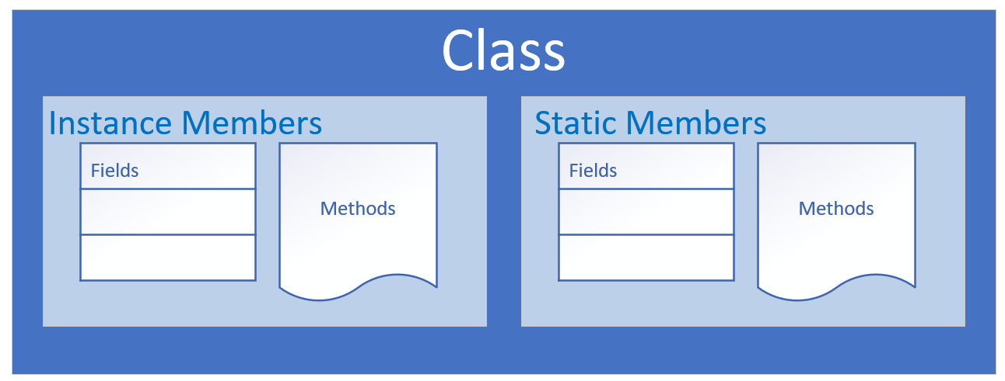
The class as the blueprint
The class describes the data (fields), and the behavior (methods), that are relevant to the real world object we want to describe.
These are called class members.
A class member can be a field, or a method, or some other type of dependent element.
If a field is static, there is only one copy in memory, and this value is associated with the class, or template, itself.
COMPLETE JAVA MASTERCLASS
Introduction to Classes and Objects

Slide 12
The class as the blueprint
If a field is not static, it's called an instance field, and each object may have a different value stored for this field.
A static method can't be dependent on any one object's state, so it can't reference any instance members.
In other words, any method that operates on instance fields, needs to be non-static.
COMPLETE JAVA MASTERCLASS
Introduction to Classes and Objects

Slide 13
Organizing classes
Classes can be organized into logical groupings, which are called packages.
You declare a package name in the class using the package statement.
If you don't declare a package, the class implicitly belongs to the default package.
COMPLETE JAVA MASTERCLASS
Introduction to Classes and Objects

Slide 14
Access modifiers for the class
A class is said to be a top-level class, if it is defined in the source code file, and not enclosed in the code block of another class, type, or method.
A top-level class has only two valid access modifier options: public, or none.
Access keyword | Description
public | public means any other class in any package can access this class.
 | When the modifier is omitted, this has special meaning, called package access, meaning the class is accessible only to classes in the same package.
COMPLETE JAVA MASTERCLASS
Introduction to Classes and Objects

Slide 15
Access modifiers for class members
An access modifier at the member level, allows granular control over class members.
The valid access modifiers are shown in this table from the least restrictive, to the most restrictive.
Access keyword | Description
public | public means any other class in any package can access this class.
protected | protected allows classes in the same package, and any subclasses in other packages, to have access to the member.
 | When the modifier is omitted, this has special meaning, called package access, meaning the member is accessible only to classes in the same package
private | private means that no other class can access this member
COMPLETE JAVA MASTERCLASS
Introduction to Classes and Objects

Slide 16
Encapsulation
Encapsulation in Object Oriented Programming usually has two meanings.
One is the bundling of behavior and attributes on a single object.
The other is the practice of hiding fields, and some methods, from public access.
COMPLETE JAVA MASTERCLASS
Introduction to Classes and Objects

